Slide 1
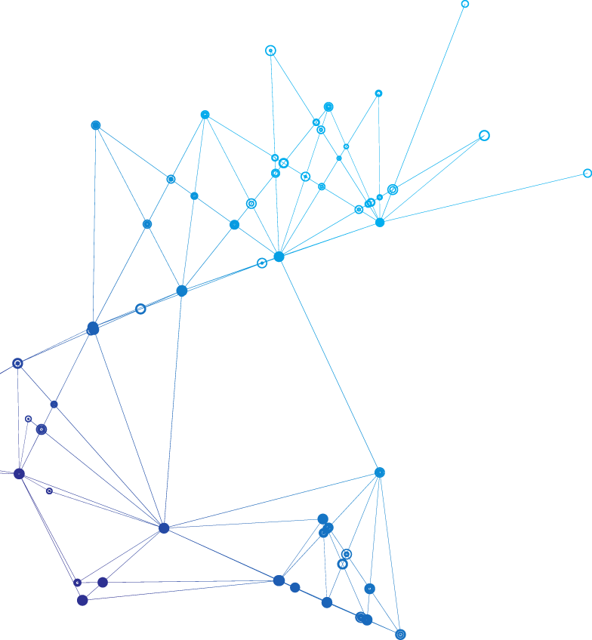
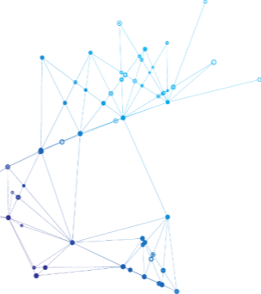
Red-Black Tree
CS566 Final Project Presentation
Group 19
Yiduo Feng,
Manpreet Gulia

Slide 2
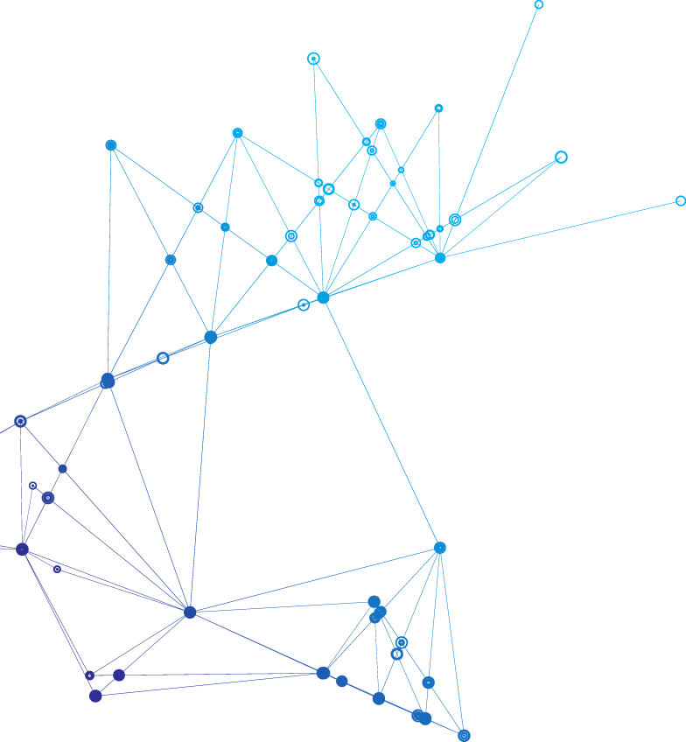

CONTENT
01
Introduction to Red Black Tree
02
Algorithm Simulation and Analysis
03
Reference

Slide 3
1
Introduction
What is red-black tree?
Rules That Every Red-Black Tree Follows
Why Red-Back Trees?

Slide 4
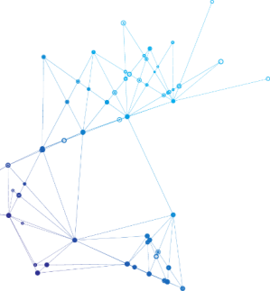
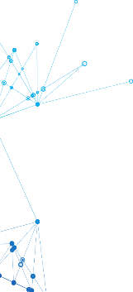
What is red-black tree?
Invented by Rudolf Bayer in 1972.
Self balancing binary search tree with an extra bit at each node.
Extra bit is often interpreted as color - Red or Black.
These colors are used to ensure that the tree remains balanced during insertions and deletions.
Although the balance of the tree is not perfect, it is good enough to reduce the searching time and maintain it around O(log n) time, where n is the total number of elements in the tree.

Slide 5
Rules That Every Red-Black Tree Follows
Every node has a color either red or black.
The root of the tree is always black.
There are no two adjacent red nodes (A red node cannot have a red parent or red child).
Every path from a node (including root) to any of its descendants NULL nodes has the same number of black nodes.
All leaf nodes are black nodes.
NIL
NIL
NIL
NIL
NIL
NIL
NIL
NIL
NIL
NIL
NIL
NIL
NIL
NIL
Violates Property 4
Violates Property 4
Violates Property 4
Following are Possible 3- Noded Red- Black Trees
All Possible Structure of a 3 - Noded Red Black Tree
Following are Not Possible 3- Noded Red- Black Trees

Slide 6
Why Red-Back Trees?
Most of the BST operations (e.g., search, max, min, insert.. etc) take O(h) time where h is the height of the BST. The cost of these operations may become O(n) for a skewed Binary tree. If we make sure that the height of the tree remains O(log n) after every insertion and deletion, then we can guarantee an upper bound of O(log n) for all these operations. In order to ensure the search efficiency and time of the binary tree, computer scientists present the distribution of the binary tree by setting more rules.
The height of a Red-Black tree is always O(log n) where n is
the number of nodes in the tree.
1
2
3
S. No | Algorithm | Time Complexity
1 | Search | O(log(n))
2 | Insert | O(log(n))
3 | Delete | O(log(n))
4
5
6
Skewed Binary Search Tree

Slide 7
2
Algorithm Simulation and Analysis
Inserting in Red - Black Trees
Searching in Red - Black Trees
Deletion in Red - Black Trees

Slide 8
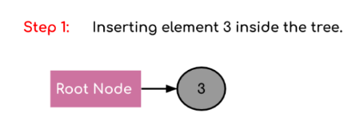
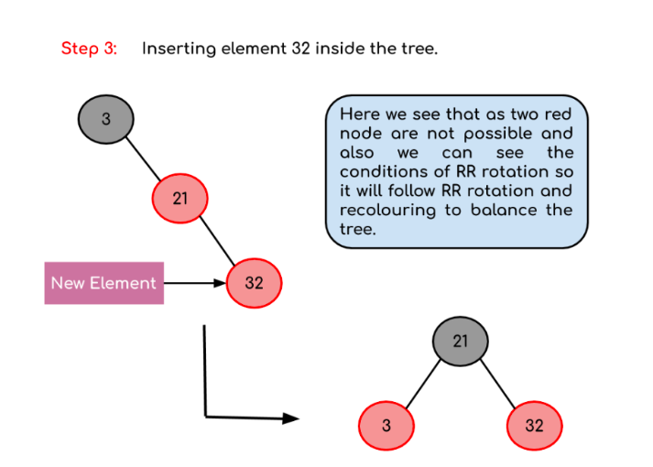
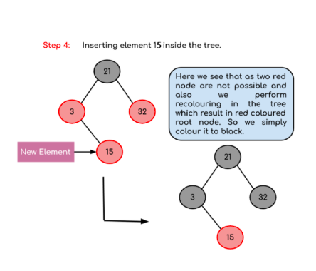
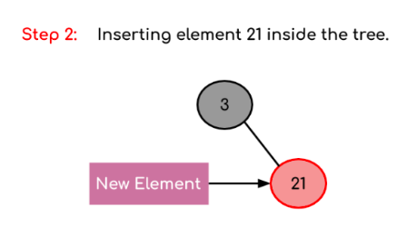
Inserting in Red - Black Trees
Insertion in Red- Black Tree has to take care of two things to balance the tree:
Recoloring - It is the change in colour of the node i.e. if it is red then change it to black and vice versa. It must be noted that the colour of the NULL node is always black
Rotation - Rotation of the tree if it is unbalanced.

Slide 9
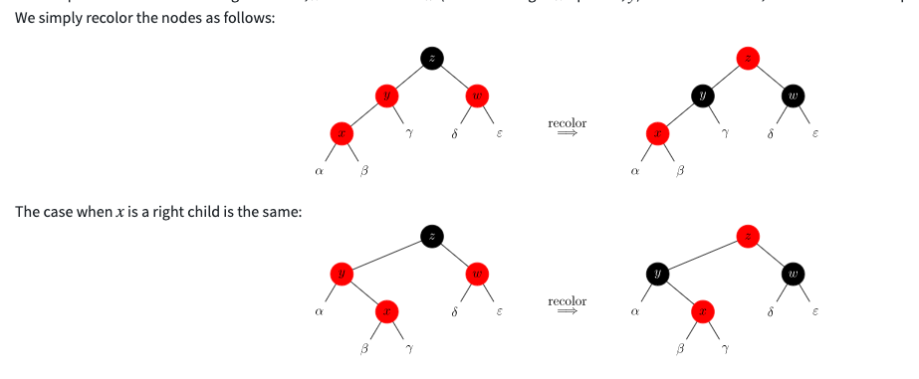
PseudoCode For Insertion
Let x be the newly inserted node. Perform standard BST insertion and make the colour of newly inserted nodes as RED.
If x is the root, change the colour of x as BLACK (Black height of complete tree increases by 1).
Do the following if the color of x’s parent is not BLACK and x is not the root.
Case 1: If x’s uncle is RED (Grandparent must have been black from property 4)
Change the colour of parent and uncle as BLACK.
Colour of a grandparent as RED.

Slide 10
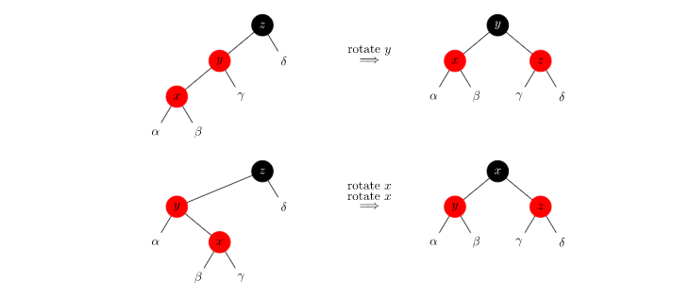
PseudoCode For Insertion
Case 2: If x’s uncle is BLACK, we just need to rotate it so it has a proper shape:

Slide 11

Inserting in Red - Black Trees
Case 1 : Red uncle ( We recolour the nodes if the color of uncle node is red)

Slide 12

Inserting in Red - Black Trees
Case 2 and 3 : Black uncle ( We recolour the nodes if the color of uncle node is red)

Slide 13
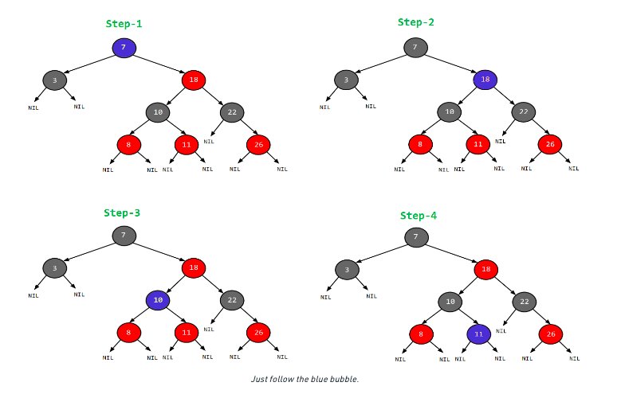
Searching in Red - Black Trees
Start from the root. Compare the inserting element with root, if less than root, then recurse for left, else recurse for right.
If the element to search is found anywhere, return true, else return false.

Slide 14
Deletion in Red - Black Trees
Like Insertion, recoloring and rotations are used to maintain the Red-Black properties.
In the insert operation, we check the color of the uncle to decide the appropriate case. In the delete operation, we check the color of the sibling to decide the appropriate case.
The main property that violates after insertion is two consecutive reds. In delete, the main violated property is, change of black height in subtrees as deletion of a black node may cause reduced black height in one root to leaf path.
Deletion is a fairly complex process. To understand deletion, the notion of double black is used. When a black node is deleted and replaced by a black child, the child is marked as double black. The main task now becomes to convert this double black to single black.
The first step is to perform the process of deletion in BST. This step is the same as any BST. While performing this type of deletion, we always end up deleting a node that either has only one child or is a leaf. So we only need to handle cases where the node is a leaf node or has only one child. Let v be the node to be deleted, and u be the child that replaces v.

Slide 15
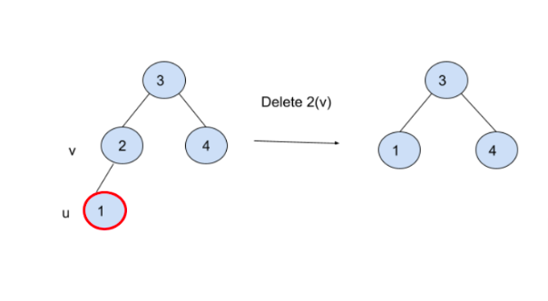
Deletion in Red - Black Trees
Case 1: If either v or u is red, we mark the replaced child as black (deletion causes no change in black height). Note that as v is the parent of u, and two consecutive reds are not allowed in the red-black tree, both u and v cannot be red.

Slide 16
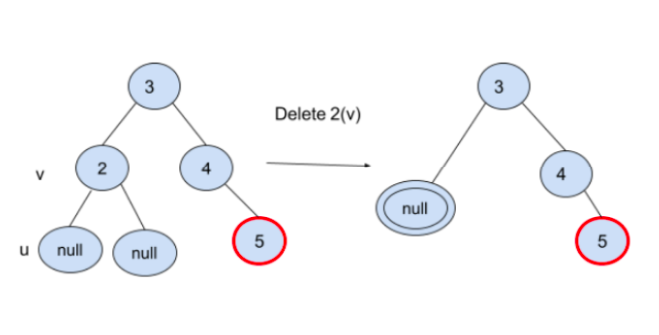
Deletion in Red - Black Trees
Case 2: If Both u and v are Black
colour u as double black (keeping a node double-black, we know exactly where the black shortage is). Now the task reduces to convert this double black to single black. Note that If v is a leaf, then u is NULL, and the colour of NULL is considered black. So the deletion of a black leaf causes a double black.
SubCase 1: If sibling node s is black and at least one of its children is red.
SubCase 2: If sibling is black and its both children are black.
SubCase 3: If sibling is red.

Slide 17
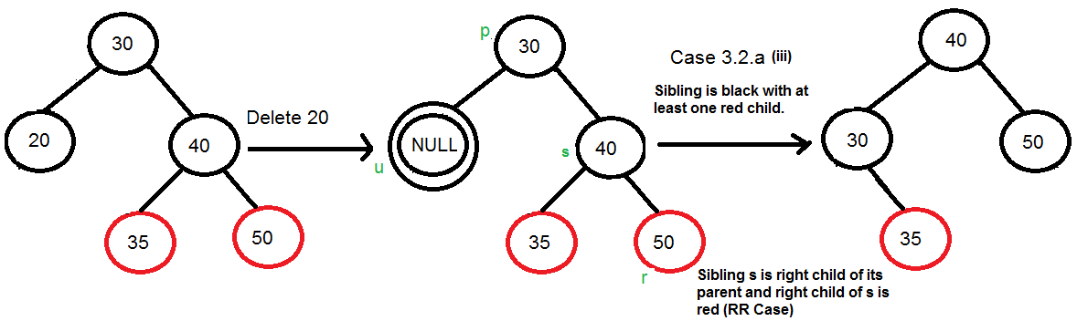
Deletion in Red - Black Trees
SubCase 1: If sibling node s is black and at least one of its children is red, perform rotation(s). Let the red child of s be r. This case can be divided in four subcases depending upon positions of s and r.
(i) Left Left Case (s is left child of its parent and r is left child of s or both children of s are red). This is mirror of right right case shown in below diagram.
(ii) Right Right Case (s is right child of its parent and r is right child of s or both children of s are red)

Slide 18
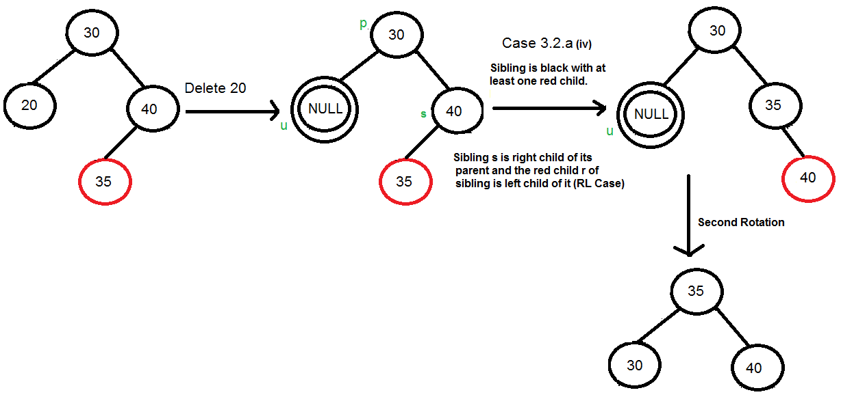
Deletion in Red - Black Trees
SubCase 1: If sibling node s is black and at least one of its children is red, perform rotation(s). Let the red child of s be r. This case can be divided in four subcases depending upon positions of s and r.
(iii) Left Right Case (s is left child of its parent and r is right child). This is mirror of right left case shown in below diagram.
(iv) Right Left Case (s is right child of its parent and r is left child of s)

Slide 19
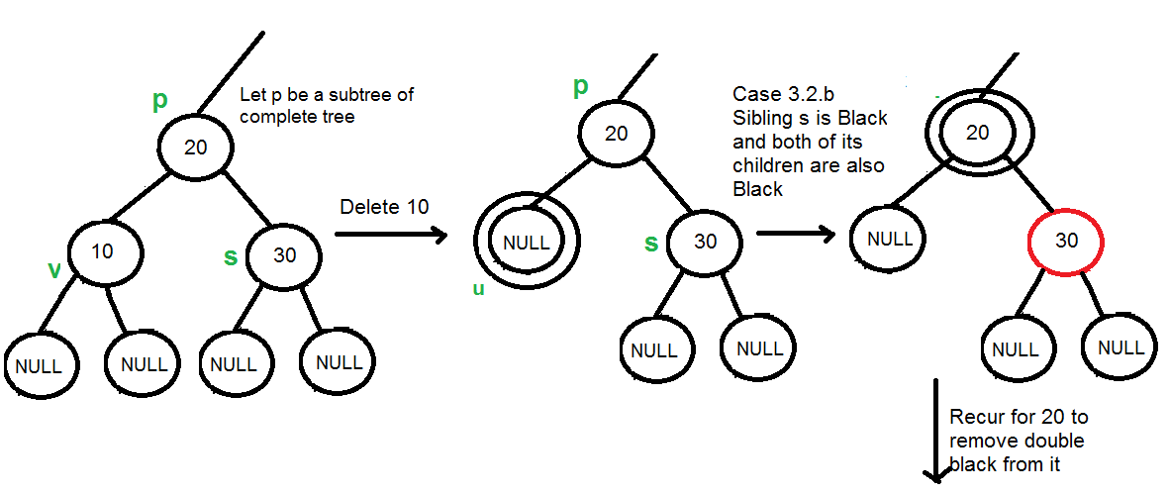
Deletion in Red - Black Trees
SubCase 2: If sibling is black and its both children are black, perform recoloring, and recur for the parent if parent is black.

Slide 20
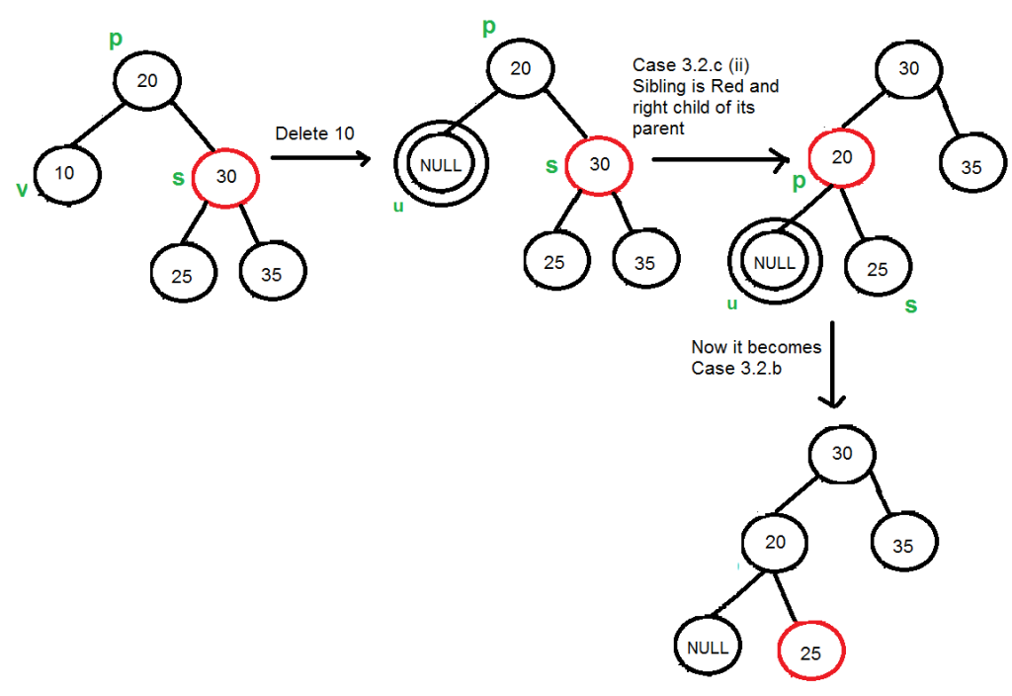
Deletion in Red - Black Trees
SubCase 3: If sibling is red, perform a rotation to move old sibling up, recolor the old sibling and parent. The new sibling is always black (See the below diagram). This mainly converts the tree to black sibling case (by rotation) and leads to case (a) or (b). This case can be divided in two subcases.
(i) Left Case (s is left child of its parent). This is mirror of right right case shown in below diagram. We right rotate the parent p.
(ii) Right Case (s is right child of its parent). We left rotate the parent p.

Slide 21
3
Reference

Slide 22
Reference Links
Geeks for geeks website: Link
Coding Ninjas website: Link
Visualization tool for Red - Black Tree: Link
Red-Black Tree Insert function: Link
Red-Black Tree Delete function: Link
Red-Black Tree Rotate function: Link
Implement Red-Black Tree in Python: Link

Slide 23
Question?

